Slide 1
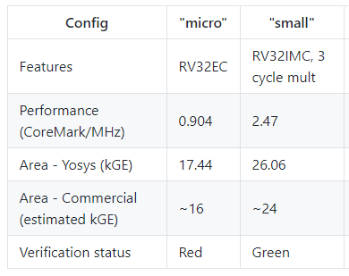


CV32E20 Project Concept (PC)
https://github.com/lowRISC/ibex/blob/master/README.md
Proposed CV32E20 Project Concept
Co-sponsored by NXP and Intrinsix
Ultra-low-end core based on ETH-Zurich ZeroRISCY
Use the IBEX core RTL design as the starting point
Intended as “minimum size” 32-bit RISC-V processor
Support for “micro” and “small” configurations
Optimized for minimum gate count and lowest power
Qualified using industry-strength verification and architecture compliance techniques
Targeted at the low-end of RISC-V MCU roadmaps
Any “compute constrained socket”
Processor element in embedded SoC subsystems

Slide 2
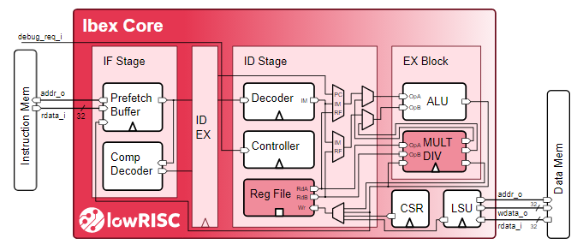
CV32E20 Project Concept (PC) Continued
Consideration for a multi-phase development
Phase 1: RTL design of Core starting from Ibex
RV32IMC and RV32EMC
OBI bus interface
CV32E40P like interrupt interface
User and Machine privilege mode
Phase 2: Create core-complex
OBI to AHB-5 bridges (Intrinsix base)
Interrupt controller design INTC (OpenTitan of Pulp base)
Debug design (Pulp of implementation of ratified debug spec)
Future Design Enhancements
Support for new compressed opcodes (Zce)
Exploration of 2-pin CJTAG debug interface
Exploration of ETH-Zurich’s “Tiny FPU”
Low granularity Physical Memory Protection module (PMP)
Project resourcing
NXP contributes architecture resource
Joe Circello (joe.circello@nxp.com)
Intrinsix contributes verification resources
Lee Hoff (lhoff@intrinsix.com)
https://github.com/lowRISC/ibex/blob/master/README.md

